Slide 1
Preparing for Power BI Certification Exam 70-778
Presented by Ted Pattison
Born Again Power BI MVP

Slide 2
Agenda
Preparing for the 70-778 Exam
Queries and Datasources
Data Modeling and DAX
Reports and Dashboards
Apps and App Workspaces

Slide 3
Skills Measured
Consume and Transform Data with Power BI Desktop (20-25%)
Model and Visualize Data (45-50%)
Configure Dashboards in the Power BI Service (25-30%)

Slide 4
Consume and Transform Data
Connect to data sources
Connect to databases, files, folders
Import from Excel
Connect to SQL Azure, Big Data, SSAS
Perform transformations
Design and implement basic & advanced transformations
Apply business rules
change data format to support visualization
Cleanse data
Manage incomplete data
Meet data quality requirements

Slide 5
Model and Visualize Data – Part 1
Create and optimize data models
Manage data relationships
Optimize models for reporting
Manually enter data
Use Power Query
Create calculated columns, tables, and measures
Create DAX queries for calculated columns, tables, and measures
Create performance KPIs
Calculate the actual, calculate the target, calculate actual to target
Create hierarchies
Use date hierarchies, use business hierarchies, resolve hierarchy issues

Slide 6
Model and Visualize Data – Part 2
Create and format interactive visualizations
Select a visualization type
Configure page layout and formatting
Setup visual relationships
Configure duplicate pages, handle categories that have no data Setup default summaries and categories,
Position, align, and sort visuals
Enable and integrate R visuals
Format calculated measures

Slide 7
Model and Visualize Data – Part 3
Manage custom reporting solutions
Use Power BI API
Use Microsoft Power BI Embedded
Enable developers to create dashboards with custom applications
Enable developers to embed dashboards in applications
Authenticate a Power BI web application
Enable developers to create custom visuals

Slide 8
Configure Dashboards – Part 1
Configure a dashboard
Connect to the Power BI service
Publish connections to services by using SSAS
Publish visualizations including data
Configure a dashboard
Add text and images
Filter dashboards
Configure dashboard settings
Customize the URL and title
Enable natural language queries

Slide 9
Configure Dashboards – Part 2
Publish dashboards
Publish to web
Publish to Microsoft SharePoint
Publish to SQL Server Reporting Services (SSRS)
Configure security for dashboards
Create a security group by using the Admin Portal
Share dashboard with users or security groups
Integrate with Microsoft OneDrive for Business
Configure row-level Security
Configure gateways

Slide 10
Configure Dashboards – Part 3
Configure organizational content packs and apps
Create a content pack
Publish a content pack
Edit a content pack
Package dashboards and reports
Configure app workspace

Slide 11
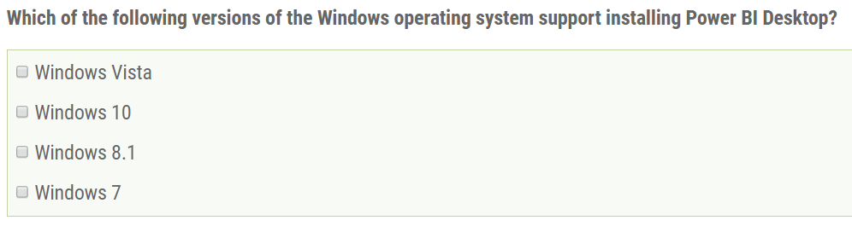
Sample Exam Question #1

Slide 12
Agenda
Preparing for the 70-778 Exam
Queries and Datasources
Data Modeling and DAX
Reports and Dashboards
Apps and App Workspaces

Slide 13
Power BI Desktop is an ETL Tool
ETL process is essential part of any BI Project
Extract the data from wherever it lives
Transform the shape of the data for better analysis
Load the data into dataset for analysis and reporting
CSV
File
Power BI Desktop
Power BI Desktop Project (PBIX)
Dataset
Excel
Workbook
OLTP
Database
Notes:
Every custom BI solution works with some type of data. Some custom solutions require integrating data from multiple data sources into a single dataset for analysis. Early in the lifecycle of a Power BI desktop project, you must discover where the data you need lives and then you must decide how you are going to import it into a dataset that will eventually be used for data analysis and reporting. This is the project lifecycle phase that is often called the "ETL" phase because it involves extracting data, transforming data and then loading data.
Power BI Desktop is a self-service ETL tool for business users. It has the ability to extract data from a variety of data source. However, the real value of Power BI Desktop is that you can perform many types of transforms to better shape the data just before it's loaded.

Slide 14
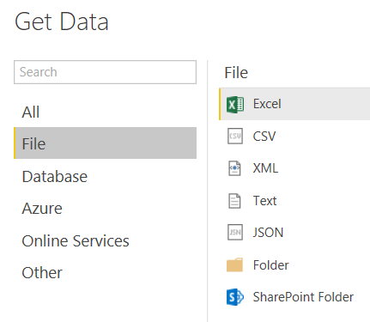
File-based Data Sources
Power BI Desktop supports common file types
Notes:
Power BI Desktop provides rich support for importing data from a wide array of file formats. You can import data from an Excel workbook which contains worksheets with named ranges and tables. You can also import data from a data model that has been created inside an Excel workbook.
It’s become an industry norm to download and make data available using text-based CSV files. If you have already completed the lab for the previous module on Power BI Desktop, then you have already worked through the steps of creating queries to import data from CSV files. You have to admit that the steps are pretty straightforward and easy to accomplish.
Power BI Desktop also supports other types of semi-structured data in common text file formats such as XML and JSON. You can create queries using the data source type of Text which allows you to leverage the data cleanup tools of the Query Editor window. This approach makes it possible to scrape data from non-structured text files when dealing with business documents such as invoices and expense receipts.
You can also use Power BI desktop to import data associated from the set of files in a folder in the local file system or a folder in a SharePoint site. This makes it possible to analyze the files and their metadata inside a specific folder in terms of the number and/or size of files by categories such as file extension, content type or date last modified.

Slide 15
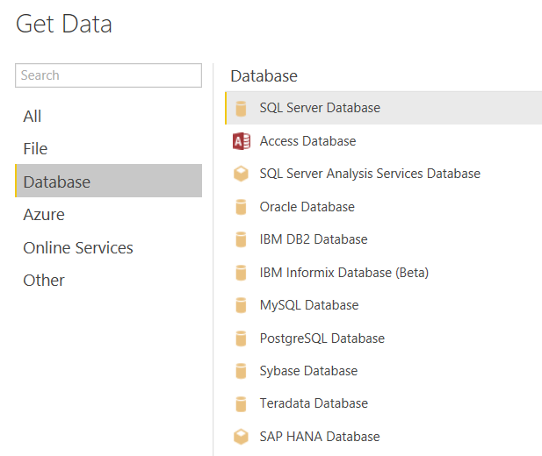
Supported Databases
Power BI Desktop supports many database systems
Notes:
Power BI Desktop supports connecting to all the industry most-popular database systems. What’s especially helpful when importing data from a database is that Power BI Desktop can read database metadata to ensure that table columns are imported with the correct data types and that table relationships defined in the database can be maintained after the data has been imported into the data model for a Power BI Desktop project.
From the list shown in the slide above, you can see that Power BI Desktop has native support to import data from Access databases as well as many popular database management systems for running OLTP-style databases including SQL Server databases, Oracle databases, DB2 databases, MySQL databases, PostgreSQL databases, Sybase databases and Teradata databases.
In addition to supporting OLTP-style databases, Power BI desktop also supports connecting to OLAP-style databases in SQL Server Analysis Services (SSAS). This includes both Tabular databases as well as class multidimensional databases which are based on multidimensional cubes and key performances indicators (KPIs).

Slide 16
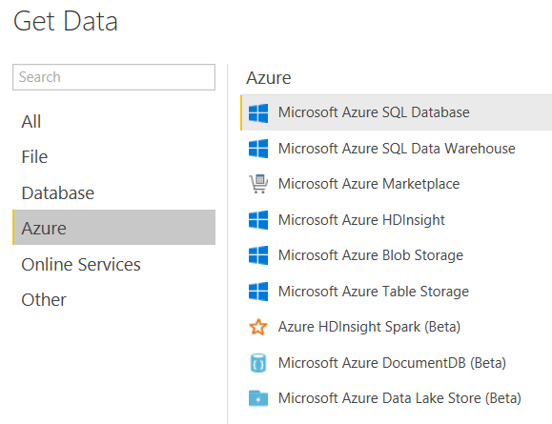
Azure Data Sources
Power BI Desktop supports many Azure data sources
Notes:
It’s clear that Microsoft is investing heavily in Microsoft Azure and Azure-based services to give its customers a cloud-based platform for building software solutions. Microsoft Azure provides several different ways to store data in the cloud including semi-structured data stored using tables, queues and blobs. Microsoft Azure also offers a cloud-based version of a SQL Server database. In fact, you will connect to an Azure SQL Server database as a data source in your next lab. That means you will get hands-on experience extracting data from the Microsoft Azure cloud in order to import customer and sales data for analysis and reporting.
Microsoft Azure HDInsight provides the means to capture large amounts of streaming data in a design process that the industry has gotten to know as “big data”. If your company is already using HDInsight, you can use Power BI Desktop to connect directly to its data or you can use an big data adapter such as Azure HDInsight Spark which provides an abstracted query layer on top of the data structures stored in an HDInsight dataset.
Microsoft Azure also provides the ability to design and populate a SQL Data Warehouse in the cloud. For companies that are taking this direction to build a cloud-based data warehouse, Power BI Desktop will be at the top of the list in in terms of effective data analytics and reporting tools to build on top of a SQL Data Warehouse.

Slide 17
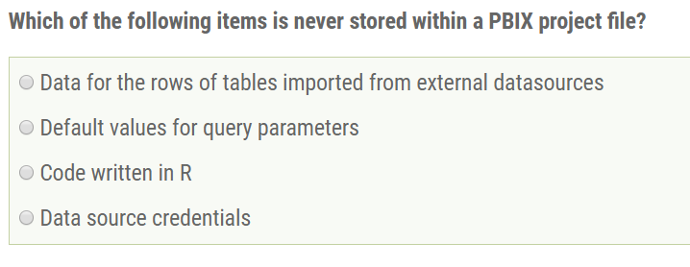
Sample Exam Question #2

Slide 18
Examples of Basic Query Steps
Rename column
Convert column type
Format column values
Replace column values
Expanding related column
Merging columns
Splitting columns

Slide 19
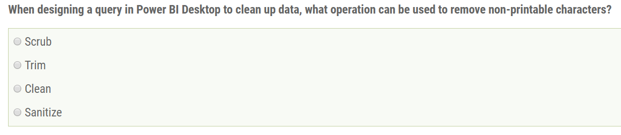
Sample Exam Question #3

Slide 20
Query Steps for Cleaning Data
Trim
Removes white space at start and end
Clean
Removes non-printable characters
Group By
Used to deduplify rows and create unique ID values

Slide 21
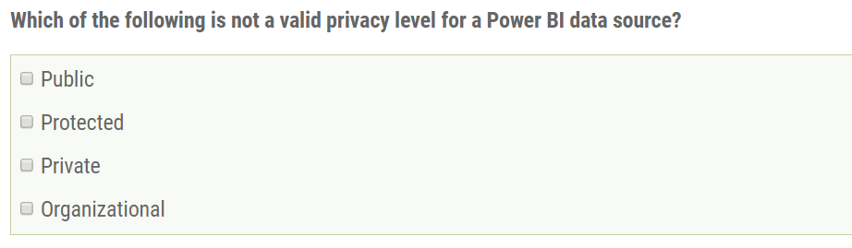
Sample Exam Question #4

Slide 22
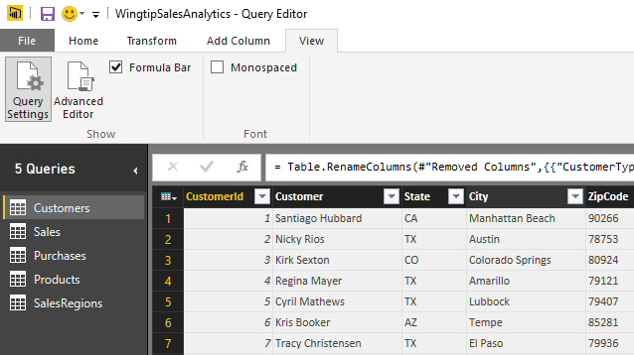
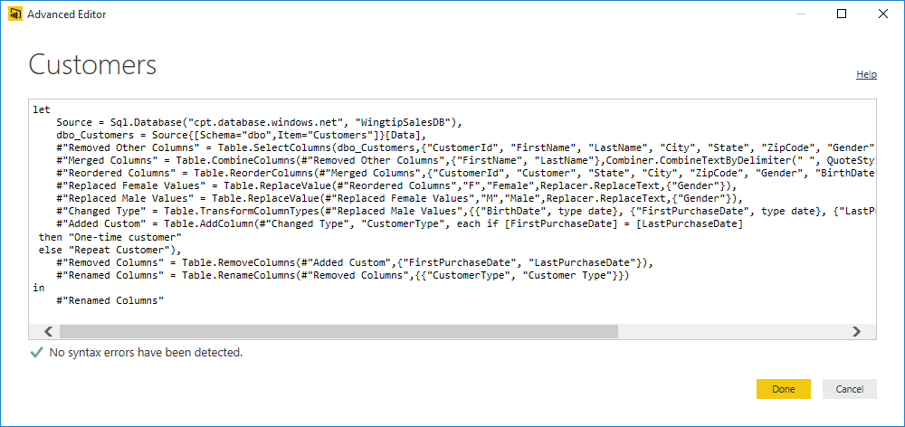
Queries and the M Language
Power BI Desktop based on "M" functional language
Query in Power BI Desktop saved as set of M statements in code
Query Editor generates code in M behind the scenes
Advanced users can view & modify query code in Advanced Editor

Slide 23
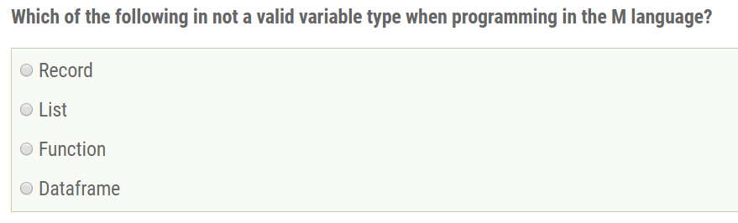
Sample Exam Question #5

Slide 24
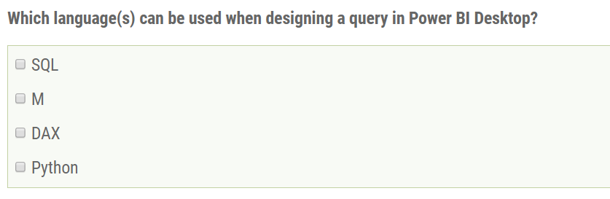
Sample Exam Question #6

Slide 25
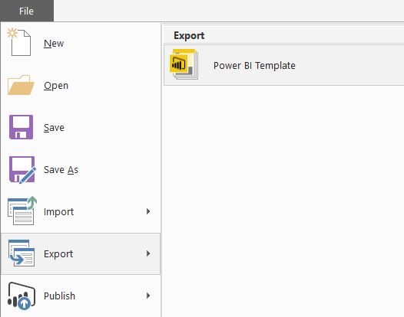
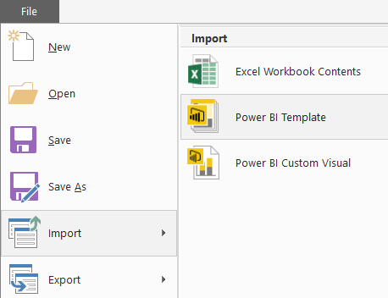
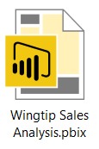

Power BI Project Template Files
PBIX project can be exported to project template file
Template file created with PBIT file extension
Generated template files contains everything except for the data
PBIT template file can be imported to create new PBIX projects
Template files are powerful when used together with parameters
How are template files used?
Export PBIX project to create a PBIT template file
Import the PBIT template file to create a new PBIX project
export
import
Notes:
About the time Microsoft added support to Power BI Desktop for creating parameters, they also added support for exporting the assets from a Power BI Desktop project to a specialized format for a project template file. A Power BI Desktop template file is like a PBIX file in that it is created as a ZIP archive using the Open Packaging Convention. You create a project template file by running the Export > Power BI Template command from the File menu. When you run the Export command, Power Bi Desktop creates the project template file by exporting assets from the PBIX file including the query definitions, the data source settings, the data modeling definitions for calculated columns and measures as well as the project’s report definition.
A Power BI Desktop project template file has a few important differences when compared to a PBIX file. First, a project template file has a file extension of PBIT instead of PBIX. Second, the project template file contains never contains any rows of data. The key idea is that exporting a project to a project template file copies everything you need except for the data itself. Therefore, PBIT files are often very small in size when compared to PBIX files. When you run the Import > Power BI Template command to import the project template file and create a new Power BI Desktop project from a PBIT template file, that is when Power BI Desktop will import the data.
Template files can be especially powerful when used together with project parameters. For example, imagine you have created a complete BI solution with a Power BI Desktop project that connects to a SQL Server database in a development environment. You can choose to create a parameter to configure the data source settings so that your project does not include hardcoded data source settings to your development database. Next, you can export the PBIX project to create a PBIT project template file containing all the definitions you have created for queries, calculated columns, measures and reports. This parameterized approach makes it easier when you deploy your custom solution to multiple customer environments which will each be running their own separate instance of the SQL Server database. When you import a PBIT file that contains the data source parameter, you will be prompted to enter the data source details for that particular customer environment. After you have configured the data source settings parameter for the new project, Power BI Desktop will execute all your queries to fill the project’s data model with rows of data from the correct database for that customer environment.

Slide 26
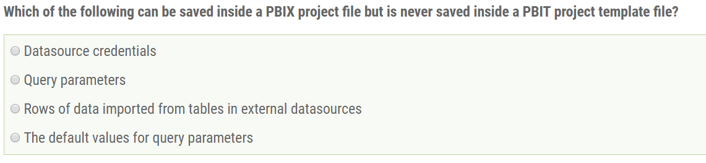
Sample Exam Question #7

Slide 27
Agenda
Preparing for the 70-778 Exam
Queries and Datasources
Data Modeling and DAX
Reports and Dashboards
Apps and App Workspaces

Slide 28
Data Modeling with Power BI Desktop
Steps to create a data model with Power Pivot
Model imported tables using a star schema
Create relationships between tables
Modify columns (formatting, data category, etc)
Create calculated columns and measures
Create dimensional hierarchies
Add Calendar table(s)

Slide 29
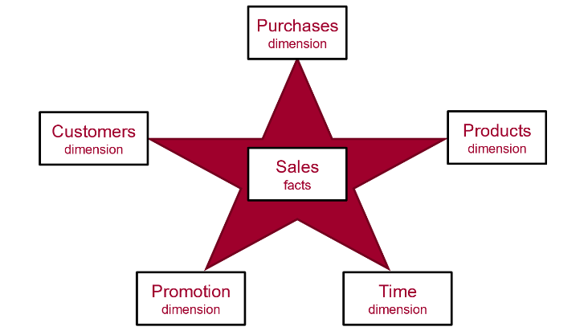
Data Modeling using a Star Schema
OLAP Modeling often based on Star Schema
Tables defined as fact tables or dimension tables
Fact tables related to dimension table using 1-to-many relationships

Slide 30
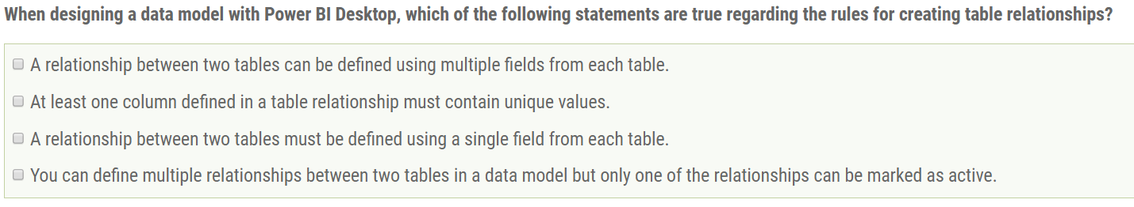
Sample Exam Question #8

Slide 31
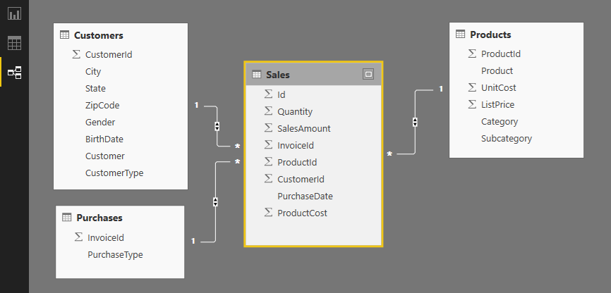
Table Relationships
Tables in data model associated with relationships
Relationships based on single columns
Tabular model supports [1-to-1] and [1-to-many] relationships
Relationships based on single column in each table

Slide 32
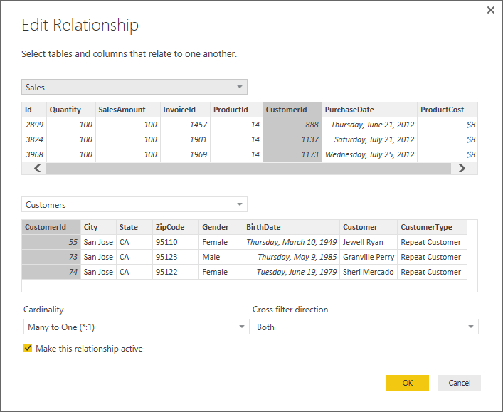
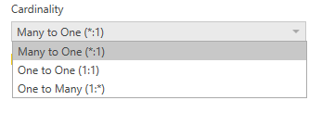

Relationship Properties
Cardinality
Cross filter direction

Slide 33
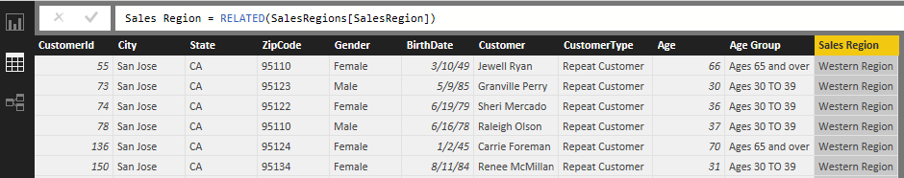
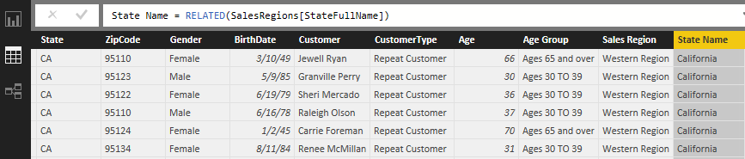
The RELATED Function
RELATED function performs cross-table lookup
Effectively replaces older VLOOKUP function
Used in many-side table to look up value from one-side
Used to pull data from lookup table into primary table

Slide 34
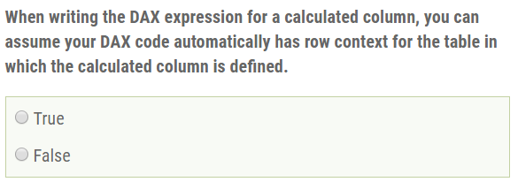
Sample Exam Question #9

Slide 35
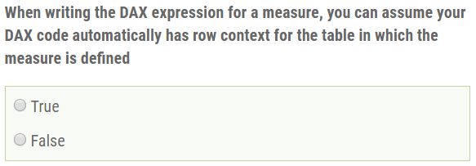
Sample Exam Question #10

Slide 36
Calculated Columns vs Measures
Calculated Columns (aka Columns)
Evaluated based on row context
Evaluated when data model is loaded into memory
Defined within scope of table inside data model
Measures
Evaluated at query time based on current filter context
Commonly used for aggregations (e.g. SUM, AVG, etc.)
Defined at scope of data model

Slide 37
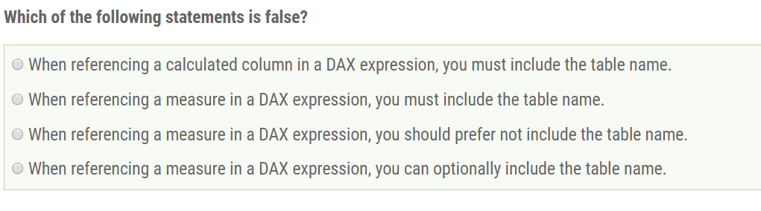
Sample Exam Question #11

Slide 38
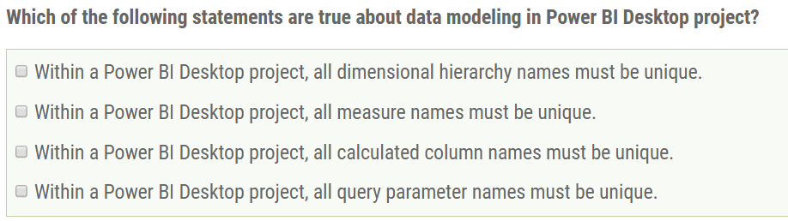
Sample Exam Question #12

Slide 39
Working with DAX
DAX is the language used to create data model
DAX stands for "Data Analysis Expression Language"
DAX expressions are similar to Excel formulas
They always start with an equal sign (=)
DAX provides many built-in functions similar to Excel
DAX Expressions are unlike Excel formulas…
DAX expressions cannot reference cells (e.g. A1 or C4)
Instead DAX expressions reference columns and tables
=SUM('Sales'[SalesAmount])

Slide 40
Types of DAX Functions
Date and Time Functions
Information Functions
Logical Functions
Mathematical and Trigonometric Functions
Statistical Functions
Filter Functions
Text Functions
Time Intelligence Functions

Slide 41
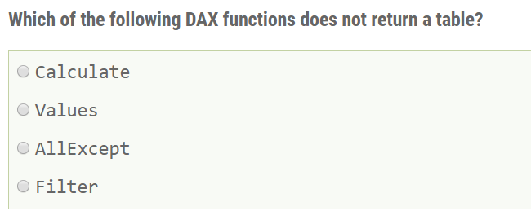
Sample Exam Question #13

Slide 42
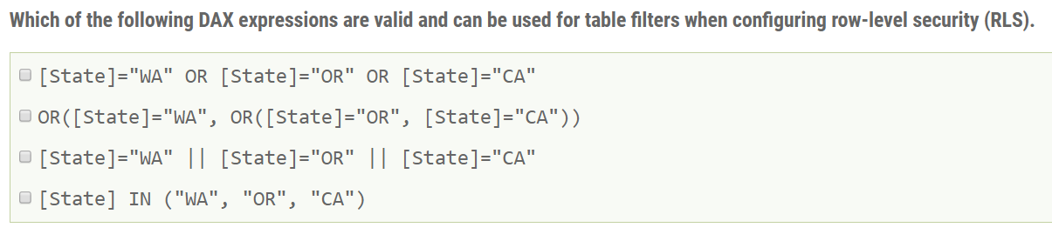
Sample Exam Question #14

Slide 43
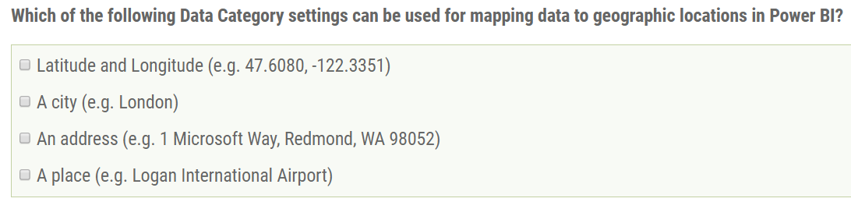
Sample Exam Question #15

Slide 44
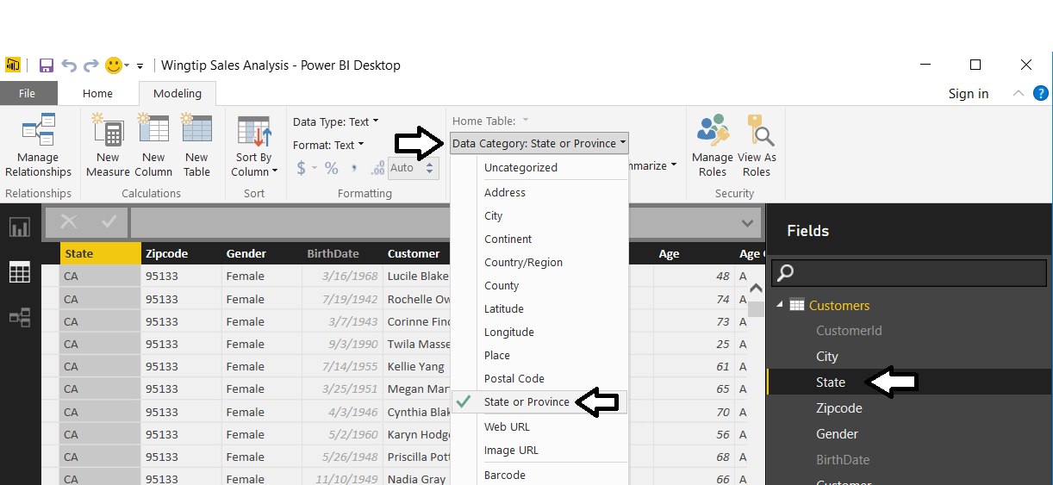
Geographic Field Metadata
Fields in data model have metadata properties
Metadata used by visuals and reporting tools
Used as hints to Bing Mapping service
“Tampa, FL” value mapped as Place and not as City

Slide 45
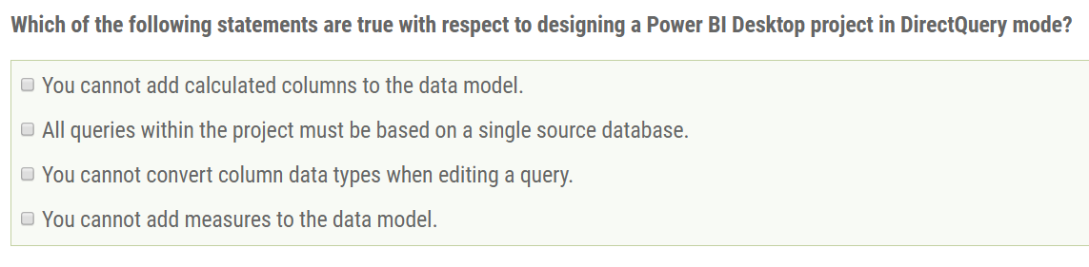
Sample Exam Question #16

Slide 46
Limitations of DirectQuery
DirectQuery imposes the following limitations
All tables must come from a single database
Many types of query steps are not supported
You cannot convert column type in a query
No special treatment of date columns
Calculated columns only allowed since June 2017
By default, limitations placed on DAX in measures

Slide 47
Agenda
Preparing for the 70-778 Exam
Queries and Datasources
Data Modeling and DAX
Reports and Dashboards
Apps and App Workspaces

Slide 48
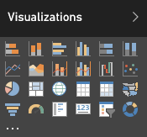
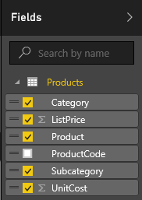
Visuals (aka Visualizations)
Reports are designed using visual (aka visualizations)
Each visuals is based on an underlying visualization type
Visualization type can be changed using Visualizations pane
Visuals creating by using fields from tables inside Fields list
Notes:
Pages within a report are designed by adding elements known as visuals. Note that Microsoft documentation uses the term “visual” and the term “visualization” interchangeably. In other words, there is no difference between a visual and a visualization. You sound a bit smarter when you use the term “visualization”, but it’s faster to say “visual” because the word only contain three syllables instead of six.
Each visual is based on an underlying visualization type. The set of visualization types available to you when designing a report are displayed in the Visualizations pane. Power BI defines a set of built-in visualization types which always appear in the Visualizations pane. One especially appealing aspect of the Power BI platform is that the set of available visualization types is extensible by adding custom visuals which you will learn about in module 6 of this training course.
When working with visuals while designing a report, you will often interact with the Fields list on the right side of the Power BI service application window. The Fields list displays all the tables and fields from the dataset associated with the current report. The Fields list is what makes it possible to associated one or more fields with a visual to populate it with data.

Slide 49
Power BI Licensing
Microsoft initially offered two Power BI licensing options
Power BI Free license
Power BI Pro license ($10/month)
Everything has been running within a shared capacity
Microsoft recently introduced Power BI Premium licensing
Power BI Premium customers can create dedicated capacities
Power BI Premium licensing has monthly fee for dedicated capacity
Dedicated capacity remove limits on upload size and # of refreshes
Dedicated capacity can serve Power BI content to non-licensed users
More info at https://powerbi.microsoft.com/en-us/pricing/
Please ask questions about licensing offline and not during lectures

Slide 50
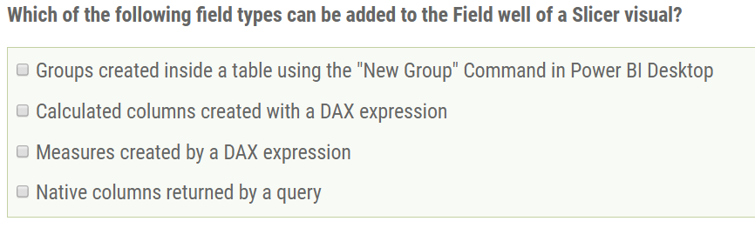
Sample Exam Question #17

Slide 51
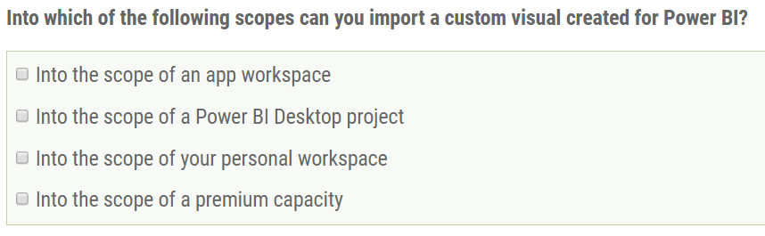
Sample Exam Question #18

Slide 52
Agenda
Preparing for the 70-778 Exam
Queries and Datasources
Data Modeling and DAX
Reports and Dashboards
Apps and App Workspaces

Slide 53
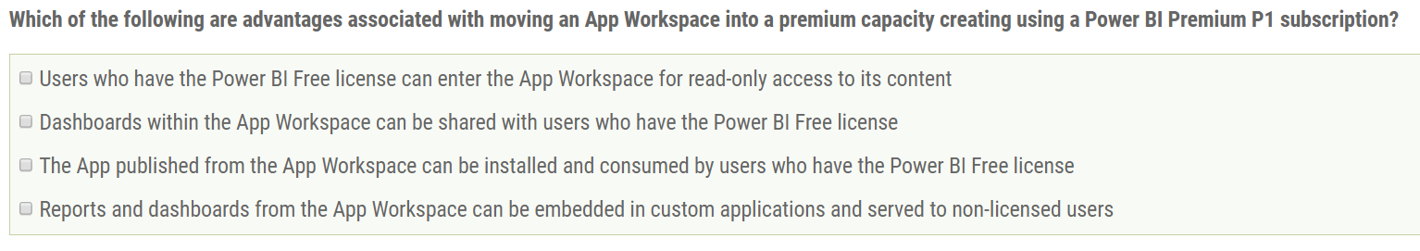
Sample Exam Question #19

Slide 54
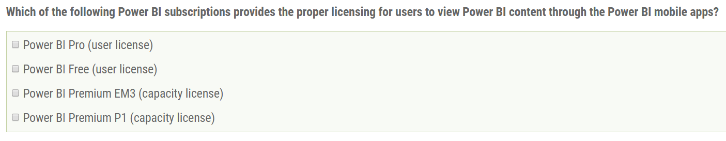
Sample Exam Question #20

Slide 55
Summary
Preparing for the 70-778 Exam
Queries and Datasources
Data Modeling and DAX
Reports and Dashboards
Apps and App Workspaces

Slide 56

Critical Path Training https://www.CriticalPathTrainig.com
PBI365: Power BI Certification Bootcamp – 4 Days
Audience is Business Users, Analysts and Data Professionals
Provides hands-on introduction to the Power BI platform
Focuses on build solutions using Power BI Desktop
Query design, data modeling and report and dashboard design
Apps and App Workspaces
Learn about “import” vs “connect to” with Excel workbooks
PBD365: Power BI Developer Bootcamp – 4 Days
Audience is Professional Developers
Teaches developing custom visuals with TypeScript and D3
Teaches R programming and integrating R with Power BI
Teaches programming with the Power BI APIs
Teaches developing with Power BI Embedded

